Slide 1
The Question of Food Security (writ large)
Philip McMichael
ESRS Presentation
Aberdeen, August 2015

Slide 2
Food Security Lineage (big pic)
“Food Security” has long lineage as a question of ‘the right to food.’
Origins in the 1941 Atlantic Charter’s vision of ‘freedom from want’ + FAO ‘essential of life.’
Marshall Plan and ‘food aid regime’ as vectors of world agro-industrialization….
Uruguay Round institutionalizes market rule:

Slide 3
Neoliberal Food Security
‘The idea that developing countries should feed themselves is an anachronism from a bygone era. They could better ensure their food security by relying on US agricultural products, which are available in most cases at lower cost.’ US Secretary of Agriculture
‘Food security is the ability to buy food.’ WB

Slide 4
Meanwhile…
Festering agrarian crisis (1980s-)→ farmer organizations from Latin America & Europe identify crisis with neoliberal policies (SAPs, ag neglect, food dependency)
FAO World Food Summit (1996): NGO Forum declared ‘food sovereignty should take precedence over macro-economic policies and trade liberalization.’
Via Campesina (1999): ‘the neo-liberal agricultural policies have led to the destruction of our family farm economies and to a profound crisis in our societies.’

Slide 5
Food dependency, 1961-2006 (FAO)

Slide 6
Argument
Neoliberal Food Security can be examined, via a critical Polanyian lens, as resembling a ‘double movement:’
Food Security as market rule–institutionalized in WTO
Food Sovereignty as the countermovement.

Slide 7
Qualifiers
A. Dualism of ‘sovereignty’ ideal:
1. right of nations: ‘the right of each nation to maintain & develop its own capacity to produce its basic foods respective of cultural & productive diversity.’ LVC 1996
2. right of peoples: advocating grassroots sovereignty -- ‘not about us without us’ → land sovereignty….
B. About embedding more than regulating markets, & ‘agrarian citizenship’ problematizes terrain of double movement (state form + political ecology vs pol ecy).

Slide 8
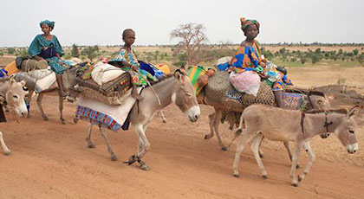
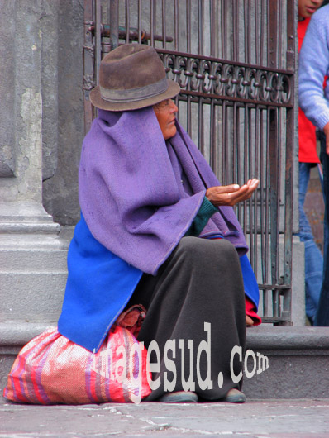
Context: destabilising impacts of cheap food regime
“the massive movement of food around the world is forcing increased movement of people” (Vía Campesina, 2000)

Slide 9
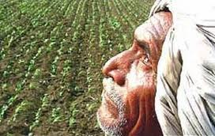
Food regime universalises export agriculture
“Whereas for small farmers the subsidies have been withdrawn, there is a lot of support now for agribusiness industry… The result is that the good area under staple foods is now shifting to export crops, so we’ll have to import staple food.”
Devinder Sharma
[Delhi NGO]

Slide 10
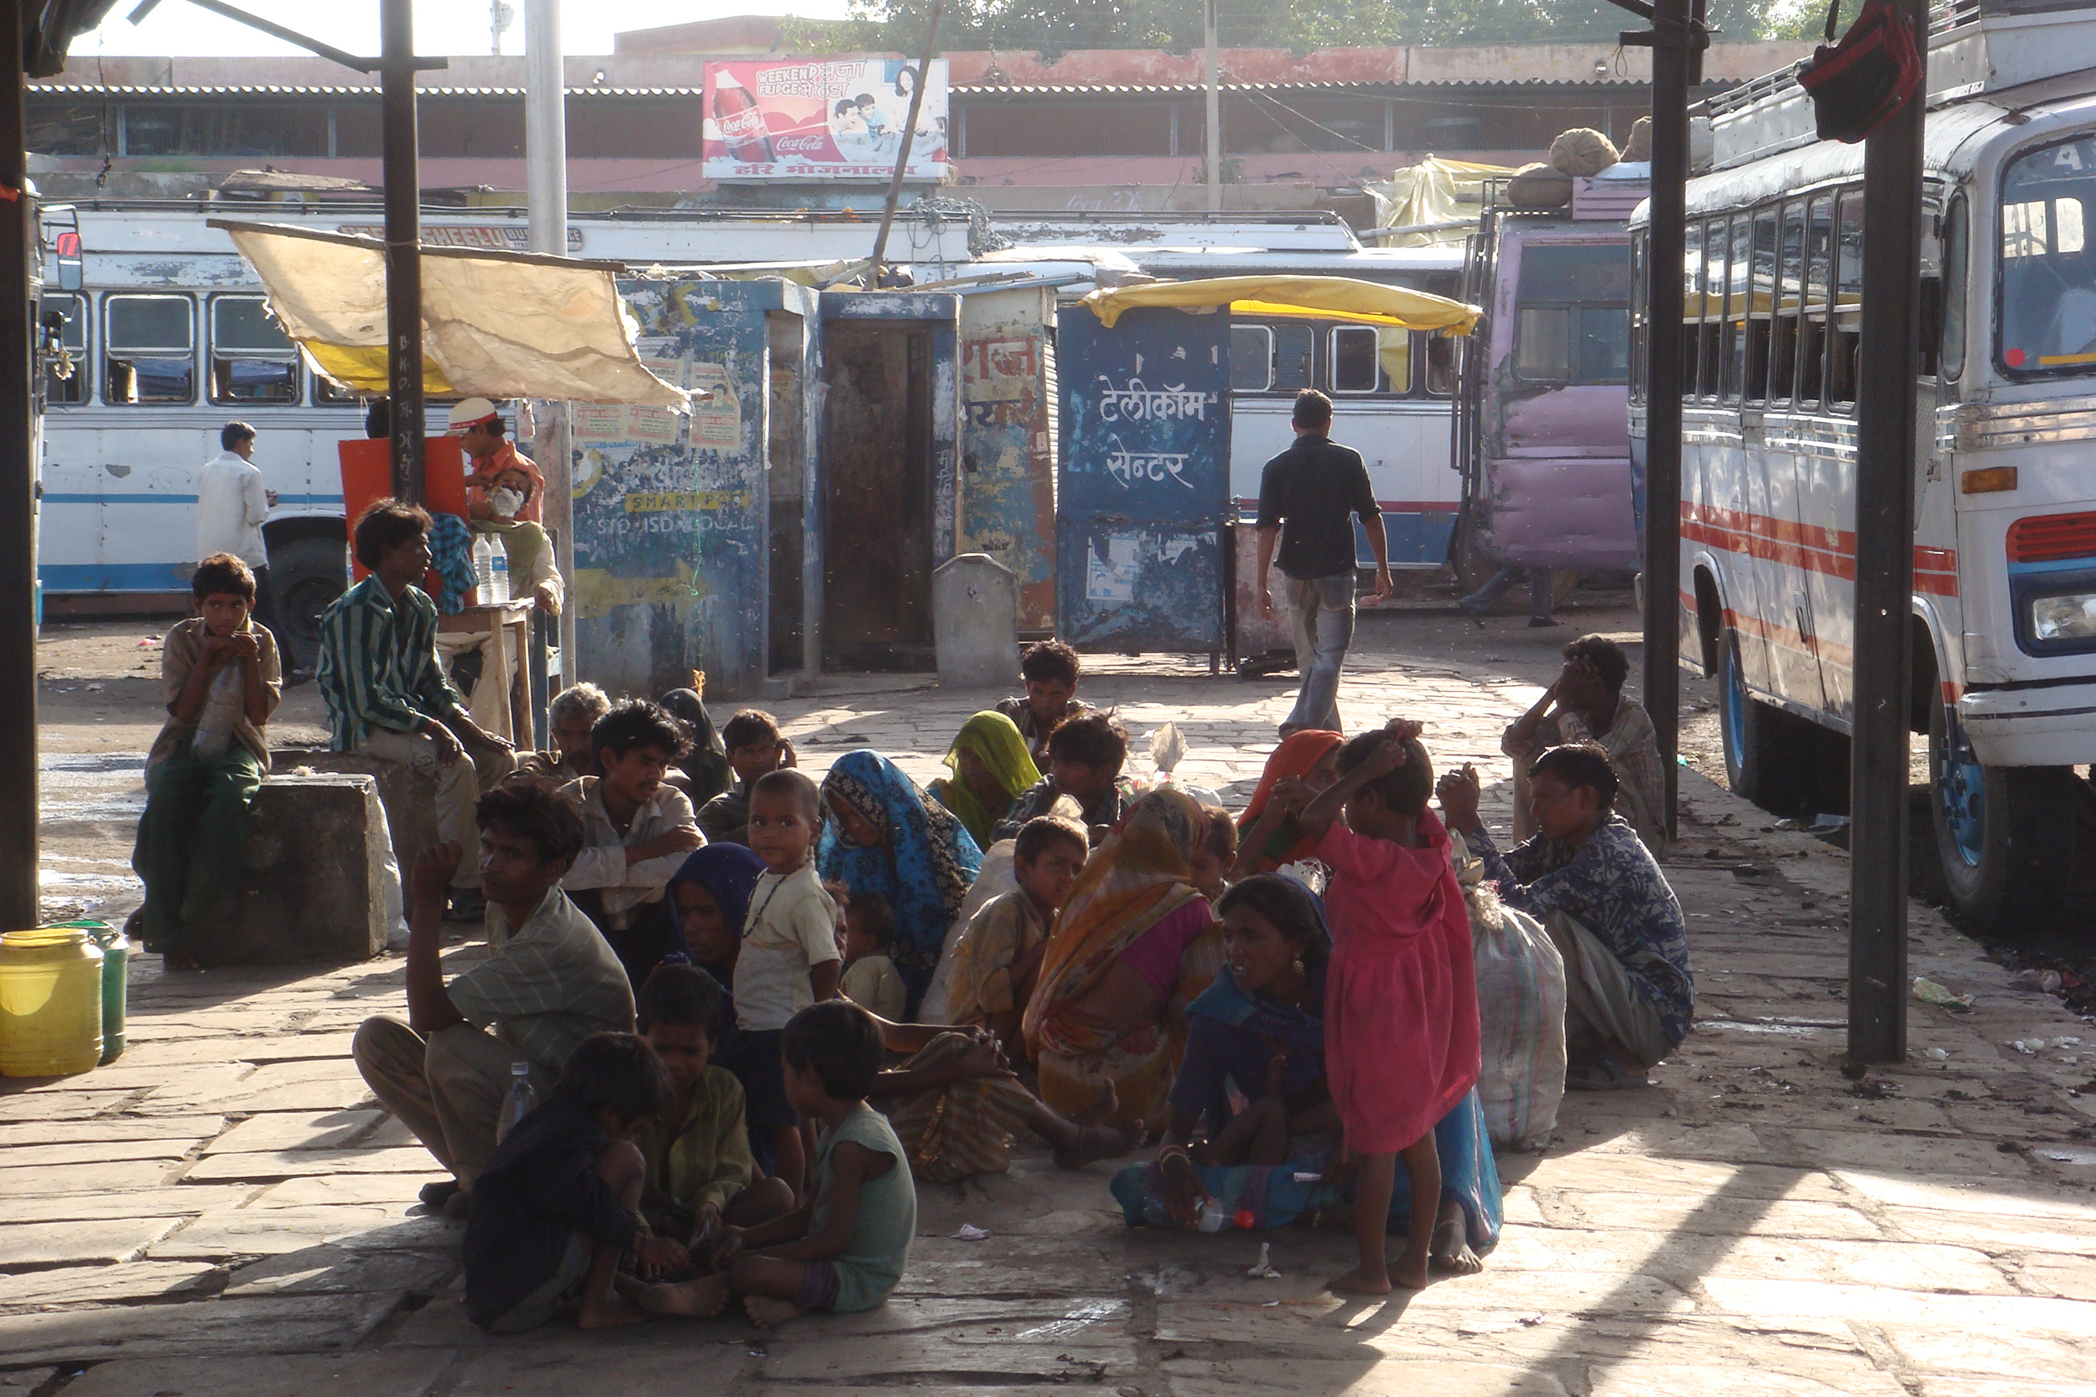
Dispossession
India: by 2015 peasant migrants ‘equal to twice the combined population of the UK, France & Germany’ (World Bank).

Slide 11
‘Food security’ illusion
‘History has shown that food security does not equal self-sufficiency of a country… Food shortages have to do with poverty rather than with being a net food importer. Food security nowadays lies not only in the local production of food, but in a country’s ability to finance imports of food through exports of other goods.” WTO Director General, 2002
Following 2008 ‘food crisis’ such comparative advantage prescriptions unravel with food export bans, precipitating agro-security mercantilism….

Slide 12
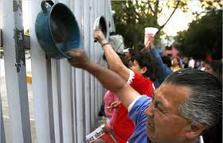
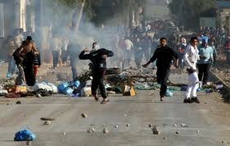
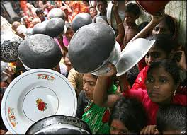
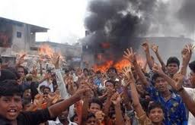
Food riots

Slide 13
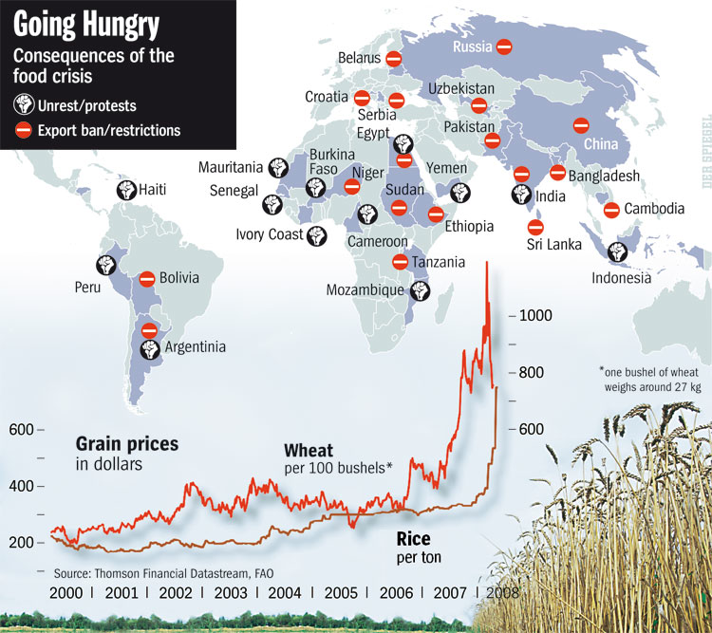
Export bans puncture ‘free trade’

Slide 14
And agro-security mercantilism

Slide 15
Food crisis, 2008: echoes of double movement
Intensified concern about hunger &/or productivity
Rome Summit → ‘outgrower’ model for small farmers via “more investment in agribusiness so that we can tap the private sector’s ability to work across the value chain.” (World Bank, WDR)
IAASTD Report: “Small-scale sustainable agriculture, locally adapted seed & ecological farming better address the complexities of climate change, hunger, poverty & productive demands on agriculture”

Slide 16
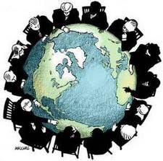
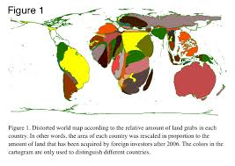
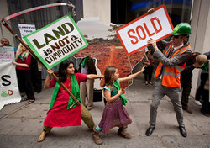
Land enclosure regime: ‘massive movement of money around the world forces increased movement of people’

Slide 17
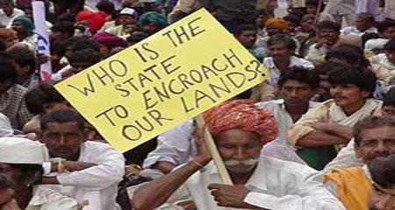
Displacement

Slide 18
Feeding the world?
WRI: feeding the 9 billion in 2050 ‘will require 70% more calories than the world consumes today.’
Counter-argument: in 2007 despite 1 billion hungry, sufficient calories were available to feed everyone at 2,796 kcal per day, and actual figure (calculated on basis of produced edible crops), is 4600 kcal pc per day before post-harvest losses: conversion into animal feed, & home waste. Also agrofuels, eg 40% US corn. (Hilmi, 2012).

Slide 19
Biofuels vs food crops
“half of all [Guatemala’s] children under five are malnourished – one of the highest rates of malnutrition in the world. Yet the country has food in abundance. It is the fifth largest exporter of sugar, coffee and bananas. Its rural areas are witnessing a palm oil rush as international traders seek to cash in on demand for biofuels created by US and EU mandates and subsidies. But despite being a leading agro-exporter, half of Guatemala’s 14 million people live in extreme poverty, on less than $2 a day.”
The Guardian (2011).

Slide 20
Why agriculture needs greening, beyond ‘green fuels’
“Agriculture is also a major contributor to global warming: by some estimates, it accounts for roughly a third of emissions globally. The industrialized, meat-heavy food system of the United States takes a heavy toll on the atmosphere; it takes an enormous amount of fossil fuel to run farm equipment and harvest the mountains of corn that fatten livestock. And most fertilizers contain nitrous oxide, a greenhouse gas 298 times more potent than carbon dioxide over a century” (M. Hertsgaard, New York Times, 9/16/12)

Slide 21
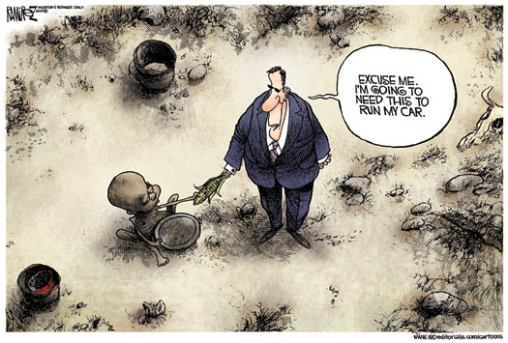
Flex-crop ontology: market disembedding

Slide 22
Where’s all this going?
‘Food security’ crisis (flex crops, financialization, meatification) legitimacy issues -- two consequences:
1. Shock doctrine at work: World Food Summit, AGRA, NAFSN, PRAI, Benchmarking the Business of Agriculture (WB: enabling private land governance).
2. Stronger presence and claims of food sovereignty countermovement regarding significance of ‘domestic food security’ (in global forums/regulating, & on the ground/embedding in food webs, ecological cycles).

Slide 23
World Food Summit (2008)
IPC Terra Preta Declaration: “The serious & urgent food & climate crises are being used by political & economic elites as opportunities to entrench corporate control of world agriculture & the ecological commons…”
– articulating shock doctrine at work: ‘yield gap’ claim, vs. IPC proposition: ‘small farmers feed the world and cool the planet’

Slide 24
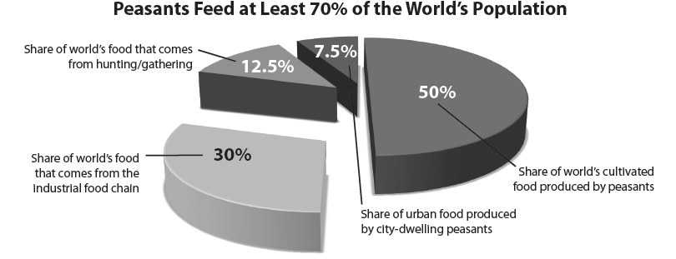
Who feeds the world? (ETC ‘09)

Slide 25
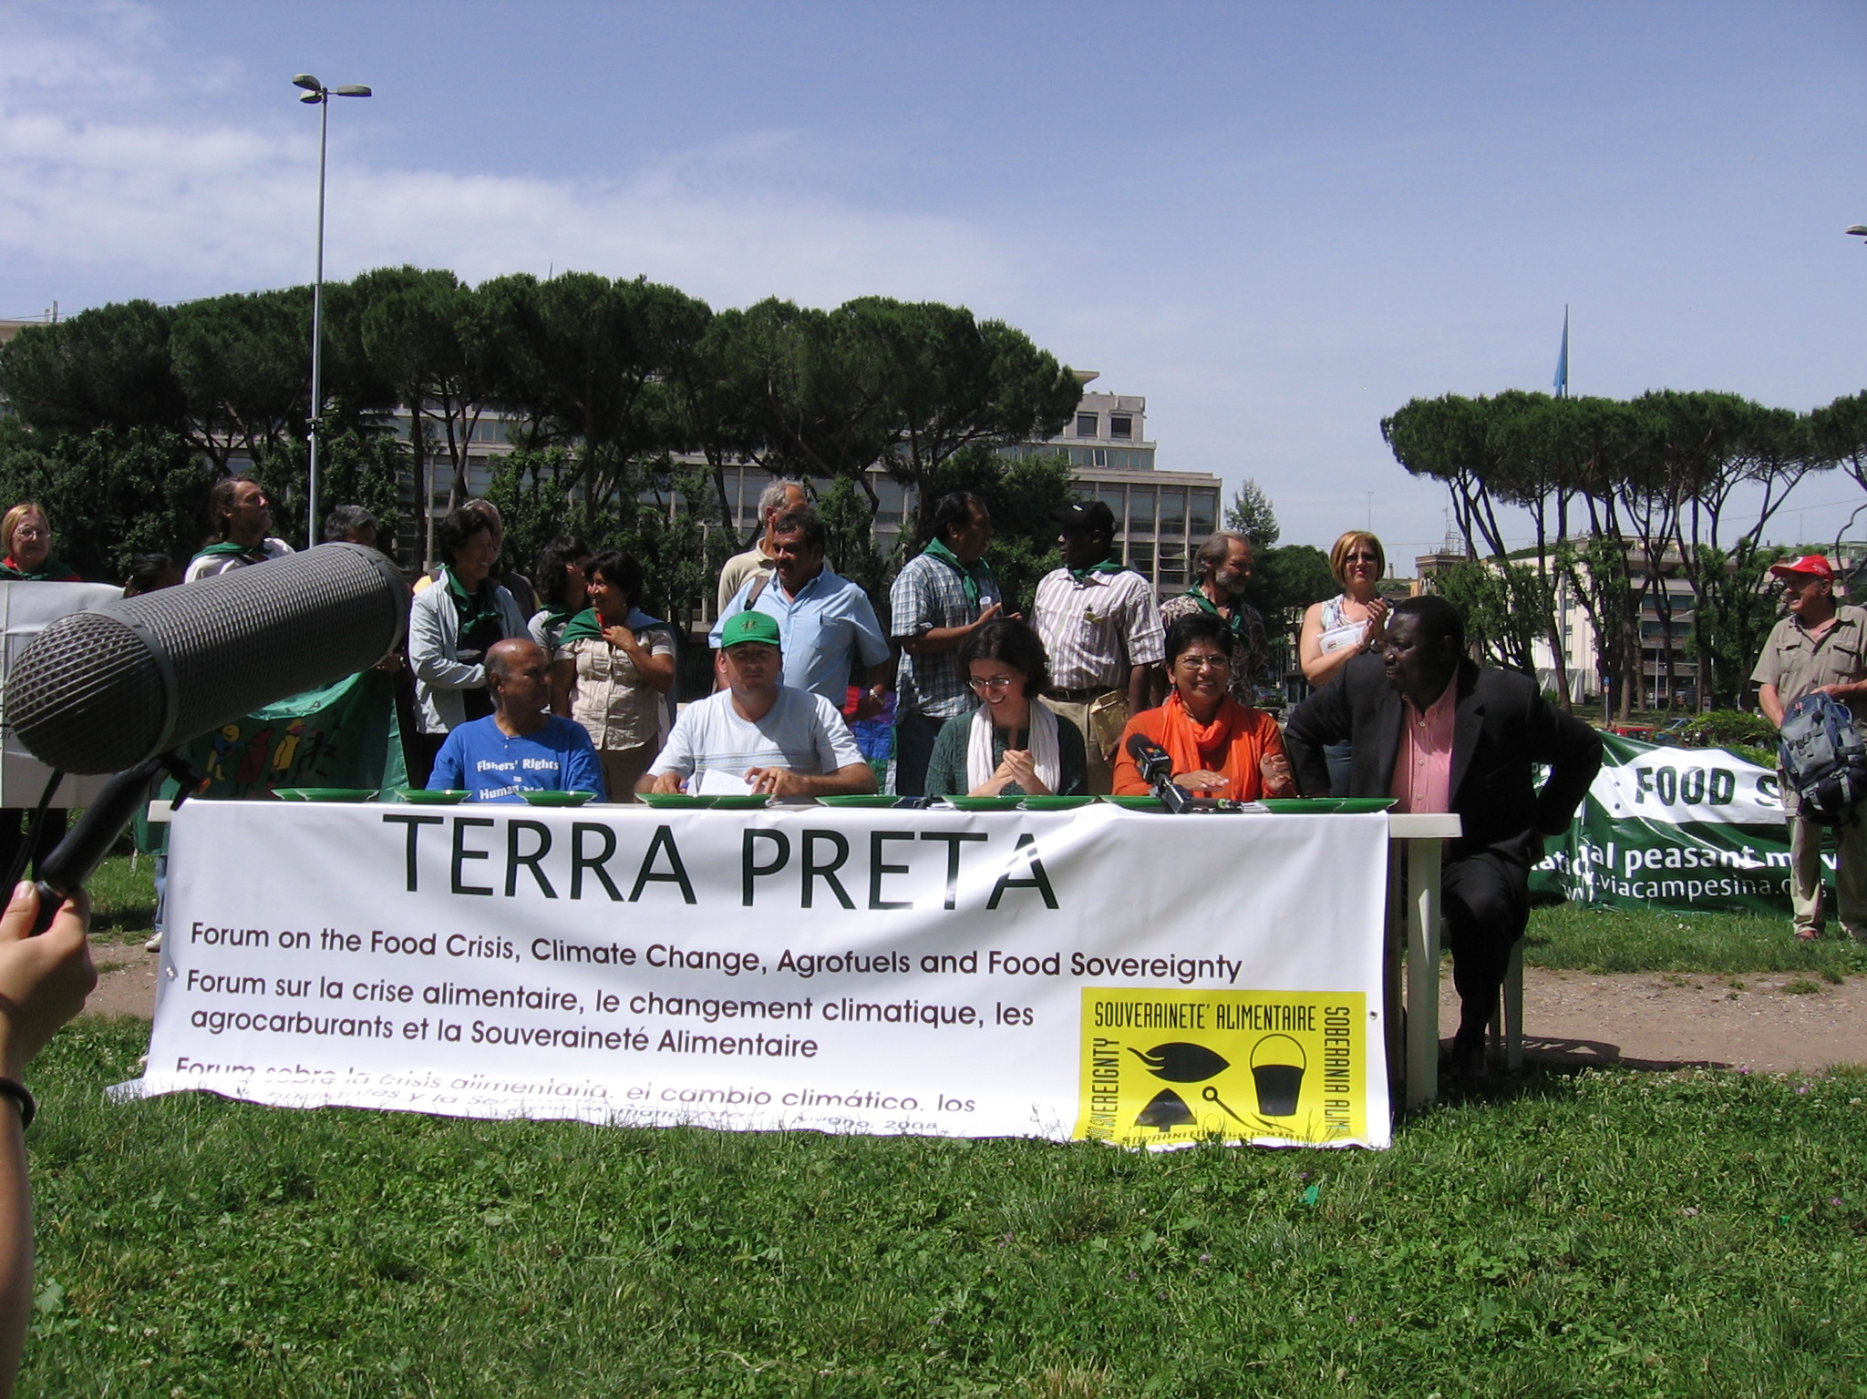

Slide 26
Food sovereignty countermovement
In context of food crisis, International Planning Committee for Food Sovereignty (IPC) forces open a civil society space in the FAO’s Committee on World Food Security (CFS)
CFS reform via Civil Society Mechanism (CSM) → Tenure Guidelines advocating recognition of customary property tenure & gender inequality.
IPC challenges World Bank’s PRAI (investor rights) with alternative rai principles, designed to protect land user rights & promote domestic food security.

Slide 27
CSM on land governance & investment
Multilateral & transparent, vs PRAI (unaccountable)
Rights-based + public protection & support of farming
Advocacy for small-scale land-users – as (1) main investors, (2) majority producers, (3) reproducers of genetic diversity, (4) domestic food security source, (5) low-input sustainers of land as public good.
Reflecting recent emphasis by FS countermovement on ‘the right to produce food’. Sovereignty = epistemic autonomy.

Slide 28
Vs. SRMkt discourse in CFS
Private Sector Mechanism of CFS: “…farming needs to be understood as a profession, and food security is about economic growth, not just growing food -- thus farmers need to break the subsistence cycle and become entrepreneurs, produce more with less land, & stabilize via land ownership, inputs (agro-chemicals), knowledge, & market access.”

Slide 29
However, CFS/HLPE report
High Level Panel of Experts (2013): “smallholder agriculture is the foundation of food security in many countries & an important part of the social/economic/ecological landscape in all countries,” &
The “potential efficiency of smallholder farming relative to larger farms has been widely documented, focusing on the capacity of smallholders to achieve high production levels per unit of land through the use of family labour in diversified production systems”

Slide 30
Agro-ecological potential
Catherine Badgley et al research in a global dataset: on average, organic farming in North produces 92% of conventional agricultural yields, but in South organic farming produces 80% more than conventional agriculture.
Bihari farmers (2013): “world record amounts of rice with no GM, and no herbicide” using only manure & the System of Root Intensification (SRI), producing “increased yields with wheat, potatoes, sugar can, yams, tomatoes, garlic, aubergine… & hailed as one of the most significant developments of the past 50 years for the world’s 500 million small farmers and 2 billion who depend on them.”

Slide 31
Capital’s counter-movement to CFS
WB Land Governance Assessment Framework: diagnostic tool, claims to follow Tenure G’s, but individual land titling for economic efficiency…
WB Benchmarking the Business of Agriculture → competition for financial investment, privatizing public resources & practices.
New Alliance for Food Security & Nutrition: Cooperation Framework Agreements for private investment, resettlement policies, value-chains. Confidential CFA’s, with 10 African states.

Slide 32
NASFN’s CFA for Tanzania
“The Government of Tanzania intends to focus its efforts, in particular, on increasing stability & transparency in trade policy; improving incentives for the private sector; developing & implementing a transparent land tenure policy; developing & implementing domestic seed policies that encourage increased private sector involvement in this area” (G8 2012).
Vs local mkts, customary land rights, seed commons

Slide 33
The food sovereignty message
Real food security begins with producer security and ecosystem security….
This is about political ecology as much as it is about political economy.
The so-called ‘double movement’ here lacks symmetry because countermovement posits an ontological alternative to a classical state/market rapprochment – from an ‘unthinkable’ movement. And it is not simply about protection, within a given system, rather it is about species survival.

Slide 34
